Slide 1
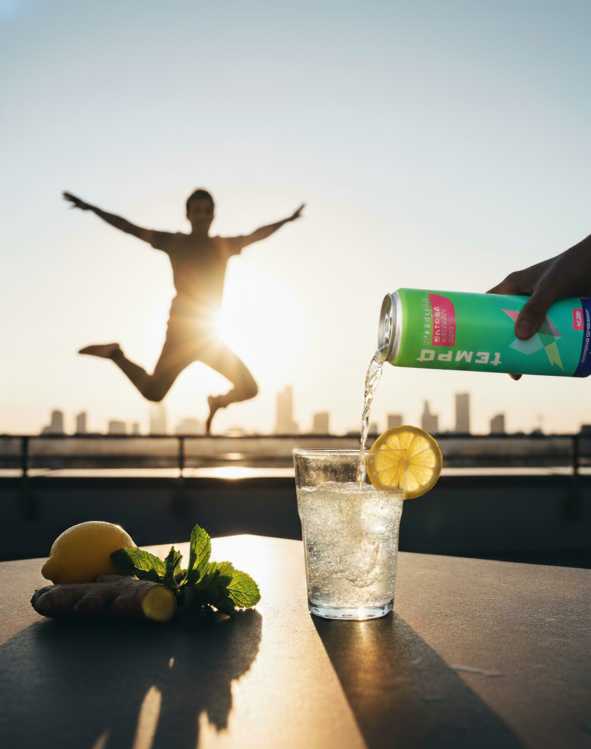
Tempo Beverages
Marketing Strategy Presentation

Slide 2


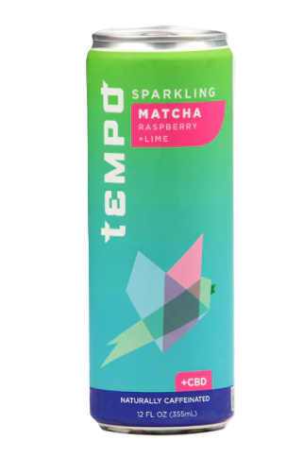


TEMPO BEVERAGES
CREATIVE STRATEGY
GET
Mindful Grinders
WHO
GET
Are looking for natural solutions that boost both productivity and mental wellness, and
leans toward coffee or energy drinks to avoid midday slump.
WHO
TO
TO
Make Tempo their go-to functional beverage
BY
BY
Showing that Tempo helps to relieve stress and gives a steady boost of energy without crashes.

Slide 3


KEY MARKETING IDEA
#StayInSync
Productivity + Wellness = Harmony

Slide 4
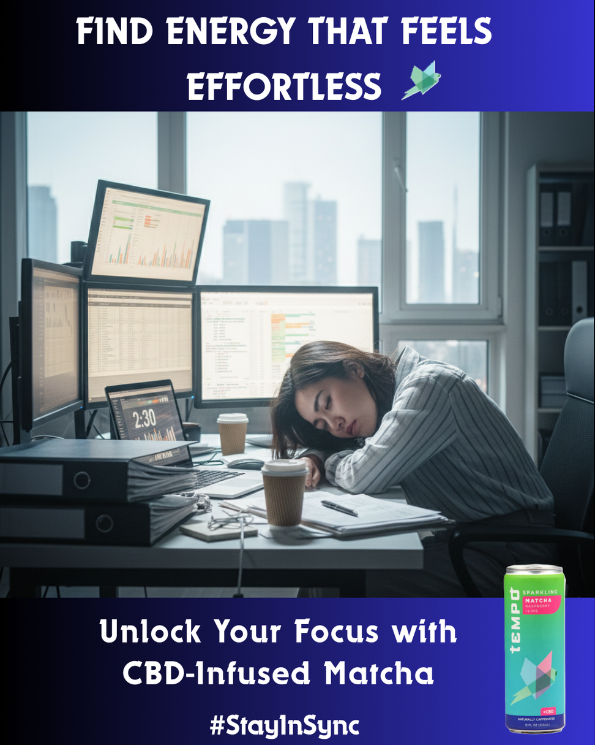
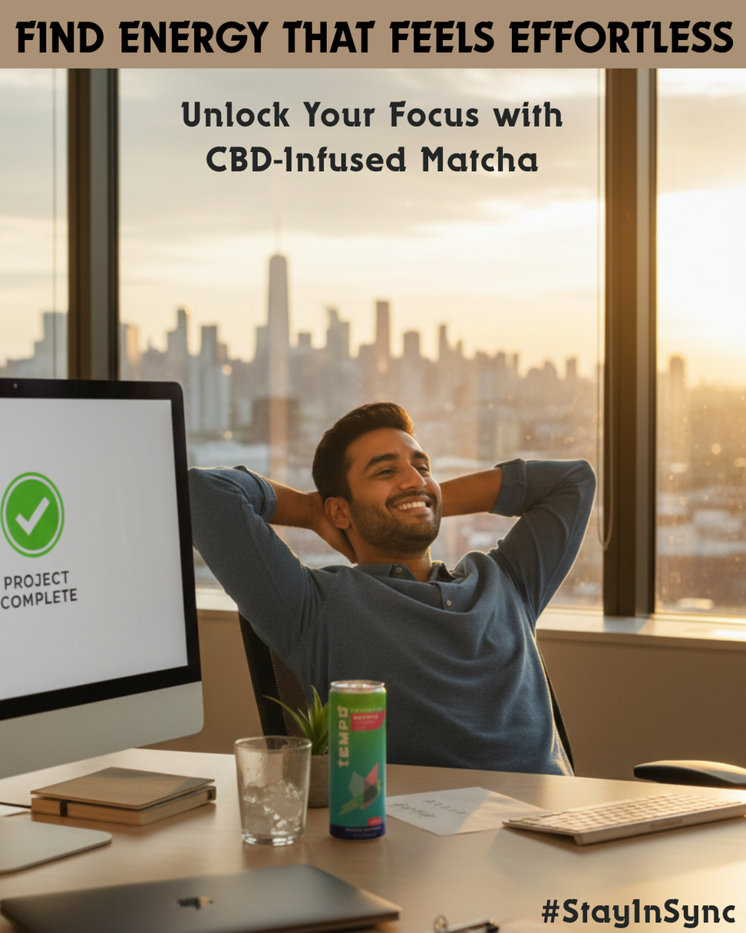

INSTAGRAM POSTS

Slide 5
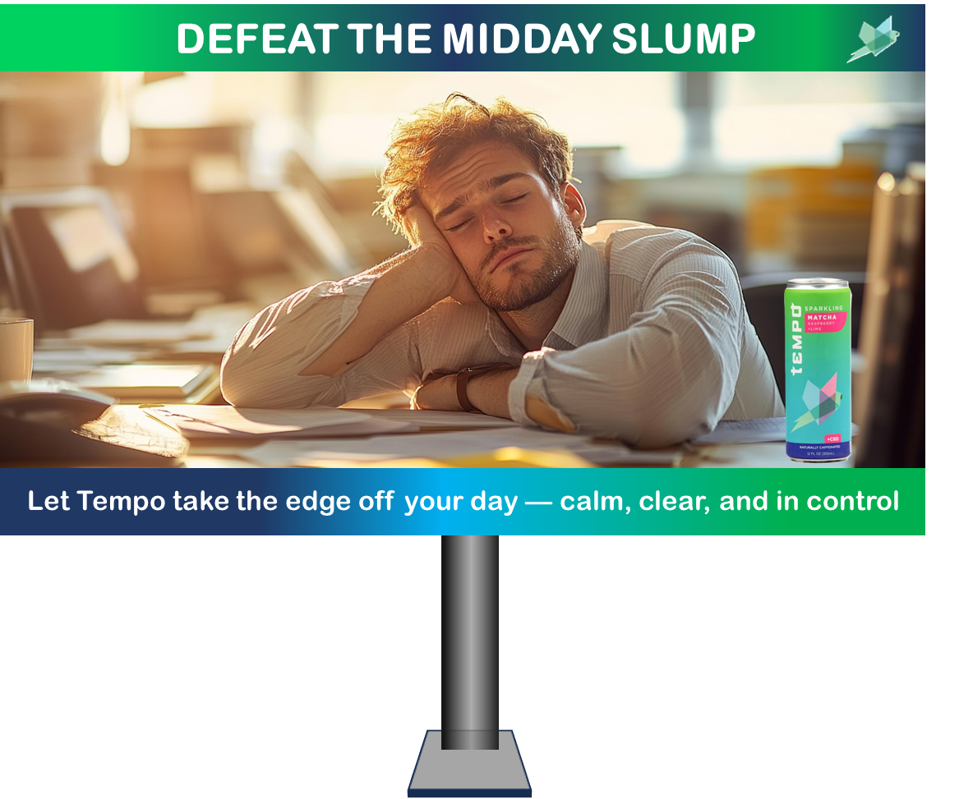
BILLBOARD CREATIVE

Slide 6
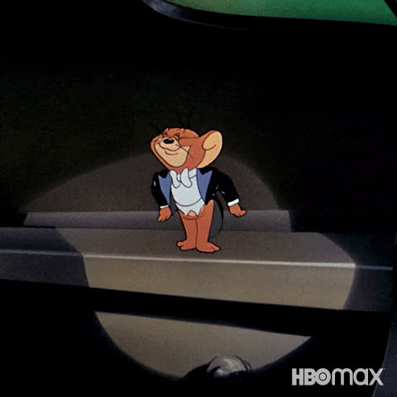
Thank You!

